Slide 1

Dynamic Access Provisioning
Team
Pramod Shanbhag
Abhilash R
Harish Reddy V.
Madhusudhan S.

Slide 2
The Problem
Selective Access Provisioning is complex
‘Employees’ should have access to servers & internet, while the ‘Guests’ have internet-only access
Selective Access Control is complex
Allowing ‘Guest’ access only for few hours
Access control using ‘macs’ and ‘IPs‘ complex
Allow ‘172.10.176.25’ or block ‘5e:ee:75:63:9f:ac’
No centralized view of the Access Network

Slide 3
Solution
Admin defines Access Policies for user/user group
Admin UI
User trying to access network, is redirected to Authentication Server
Packet redirection using header re-write flows.
Authentication Server informs SDN Controller on successful authentication.
REST APIs
SDN Controller provisions and manages Access based on defined Policies.
Flow program

Slide 4
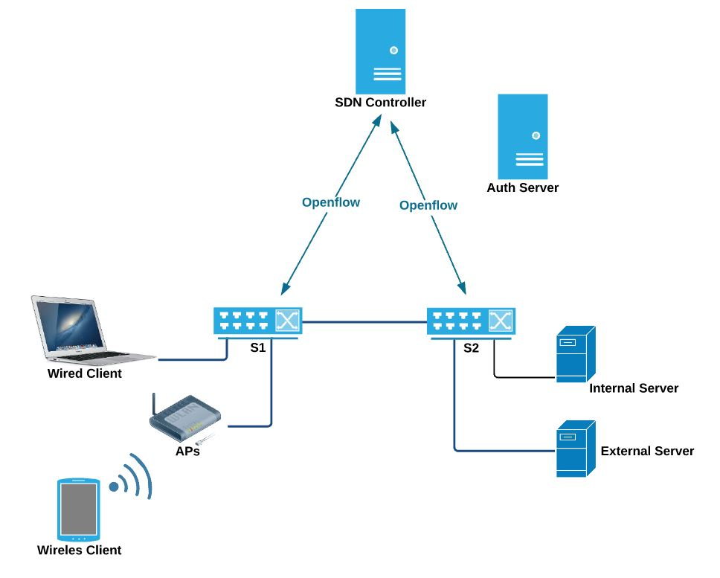



Solution Details - Architecture

Slide 5
Demo Details

Slide 6
Key Takeaways
Policy Based Access Provisioning
‘Same’ hotel network can be accessed ‘differently’
by ‘Employee’ and ‘Guest’.
Dynamic Access Control
Manage Guest access with check-in/check-out
‘User’ centric Policies
Manage policies for ‘Users/UserGroup’ – not ‘macs’ or ‘IPs’
Centralized Network Surveillance
‘Centralized’ monitoring for ‘Intrusion’
REST API based – Integration and extensible

Slide 7
Key Takeaways
Future :
Programmable Firewall
Access ‘changes’ at different times of day.
Access ‘changes’ for ‘selective slice’
BYOD
‘Same’ User Policies for ‘All’ his devices
Project :
https://github.com/onfsdn/access_prov

Slide 8
Q & A

Slide 9

Thanks!

